Slide 1
AWS LAKE FORMATION

Slide 2
OVERVIEW
A data lake is a central repository that allows you to store all your structured and unstructured data at any scale.
It allows you to break down data silos and combine different types of analytics to gain insights and guide better business decisions.
Often, setting up these data lakes requires a large amount of manual work, which can be complex and time-consuming.
Unlike data warehouses, data lakes can hold raw data in its original format until needed.
Lake Formation simplifies and automates many of the complex manual steps required to create these data lakes.

Slide 3
AWS Lake Formation is a fully managed service that makes creating, maintaining, and managing data lakes a breeze.
AWS Lake Formation automates most of the data lake construction process, reducing the time it takes from months to weeks.
The service acts as a single point of control for identifying, retrieving, cleaning, and transforming data from thousands of sources, as well as enforcing security regulations across various services and acquiring and managing fresh data.
AWS Lake Formation is controlled via a single dashboard from which you can configure and alter all data lake lifecycle phases and operations.

Slide 4
The Core Problem It Solves
Building a data lake from scratch is difficult:
Ingesting Data: You have to collect data from various sources (databases, SaaS apps, streams) in different formats.
Cleaning & Cataloging: You need to deduplicate, standardize, and transform data to make it usable. You also have to create a searchable catalog so people can find the data.
Securing Data: This is the biggest challenge. You must set up fine-grained access controls (e.g., "User A can only see the 'email' column for customers in 'USA'") across all analytics engines, which is incredibly complex and error-prone when done manually.

Slide 5
What AWS Lake Formation Does
Data Ingestion & Storage
Import data from on-premises databases, Amazon S3, and AWS services.
Store data in S3 in a structured and secure way.
Data Cataloging
Automatically crawls and catalogs data in the AWS Glue Data Catalog.
Maintains a central metadata repository for discovery and query.
Data Transformation & Preparation
Use ETL jobs (via Glue) to clean, transform, and format data for analytics.
Security & Access Control
Centralized fine-grained permissions for tables, columns, and rows.
Works across services like Athena, Redshift Spectrum, EMR, QuickSight.
Governance & Compliance
Unified security policies and data governance.
Tag-based access control for sensitive datasets.

Slide 6
How It Relates to Other AWS Services
Lake Formation is not a storage or compute service. It's a management layer that orchestrates other services:
Amazon S3: The durable storage foundation of the data lake.
AWS Glue: Provides the serverless ETL engine, data catalog, and data crawlers that Lake Formation uses heavily.
Amazon Athena, Amazon Redshift, Amazon EMR, Amazon QuickSight: These are the analytics engines that query the data. Lake Formation applies security policies to them.
AWS IAM: Lake Formation works on top of IAM, using IAM principals (users/roles) to define who has access, while Lake Formation defines what they have access to.

Slide 7
Use Case
A company wants to analyze sales data stored in an RDS database and clickstream logs in S3.
With Lake Formation:
An admin uses a Lake Formation blueprint to ingest the data from RDS and S3 into a central S3 bucket.
Lake Formation automatically catalogs the data.
The admin uses the Lake Formation console to:
Create a database called sales_analytics.
Grant SELECT permissions on the sales_data table to the "Analysts" IAM role.
Revoke access to the customer_pii column for that same role.
An analyst using Athena, who assumes the "Analysts" role, can now query the sales_data table but will get a permission error if they try to SELECT customer_pii. The security is enforced seamlessly.

Slide 8
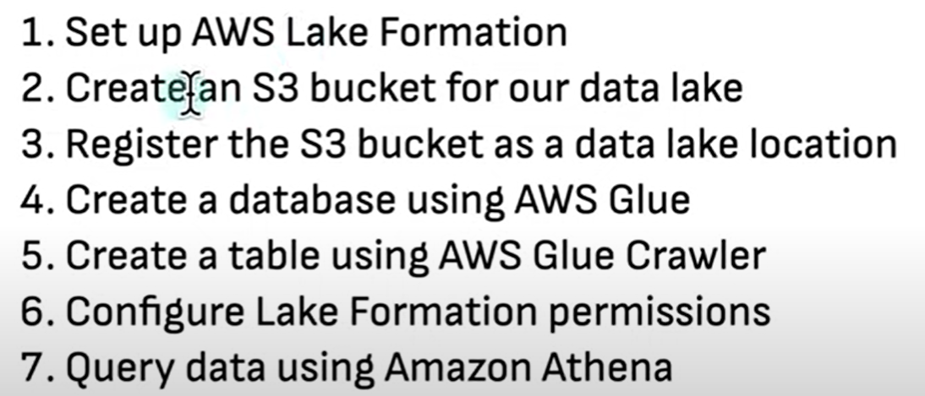
Basic Lake formation steps

